Slide 1

Predicting Nutrition Density
David Berberena

Slide 2
Background
Food has been analyzed in many different ways for as long as humans have lived.
Recently, America has been pursuing food for enhanced dieting, weight loss regimens, and increased knowledge.
The nutritional and dietary needs sector of the food industry focuses on providing the most informed recommendations on what foods help to stay healthy.

Slide 3
The Problem
An overabundance of junk food (or any food not consumed in moderation) in a person’s diet may lead to medical issues, and nutritionists and dieticians need to have proven food regimens for these individuals to regain their health.
Predicting the nutrient density of food ingredients so organizations like the USDA and the FDA can provide the most accurate information to consumers through their daily dietary needs recommendations and other suggestions is paramount to ensuring their continued credibility.

Slide 4
The Data
Variable Name | Description
Food | The name or type of the food item
Caloric Value | Total energy measured in kilocalories per 100 grams
Fat | Total amount of fats (in grams)
Saturated Fats… | Fats that typically raise the level of cholesterol in the blood (in grams)
…Potassium | Helps regulate fluid balance, muscle contractions, and nerve signals (in mg)
Selenium | Important for reproduction, thyroid gland function (in mg)
Zinc | Necessary for the immune system to properly function and plays a role in cell division (in mg)
Nutrition Density | A metric indicating the nutrient richness of the food per calorie

Slide 5
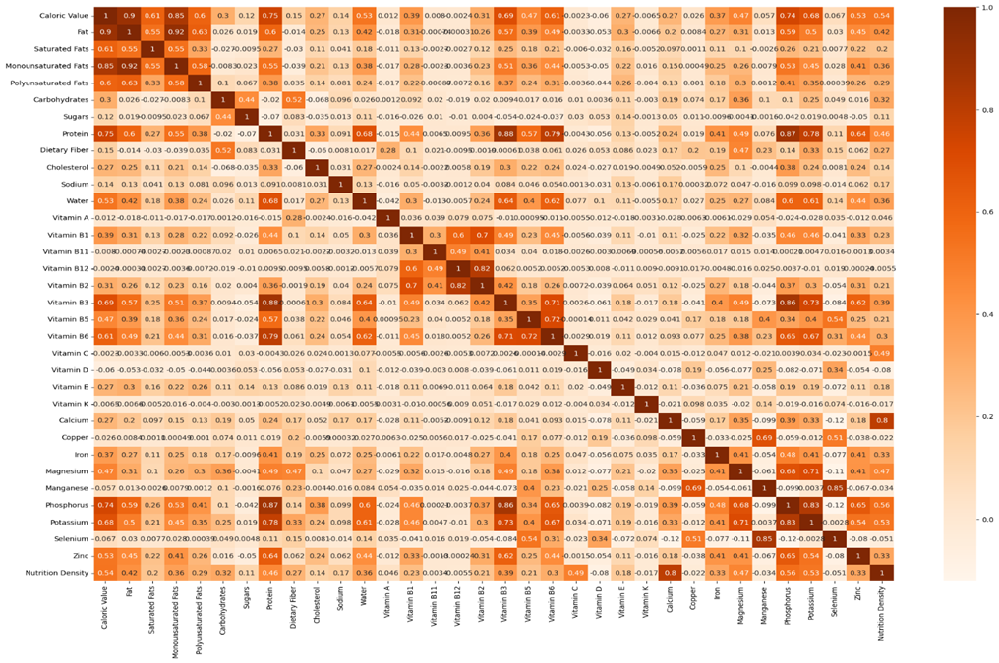
Correlation EDA

Slide 6
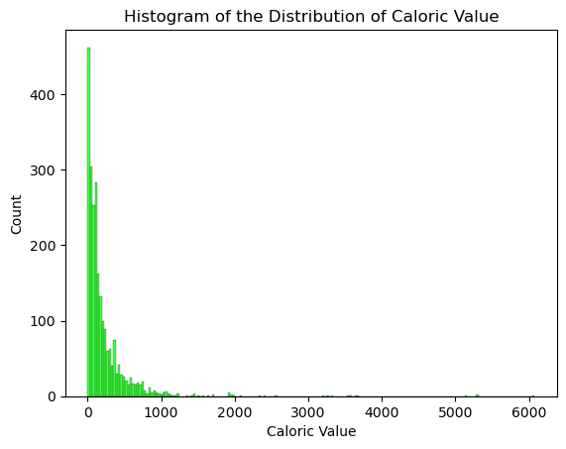
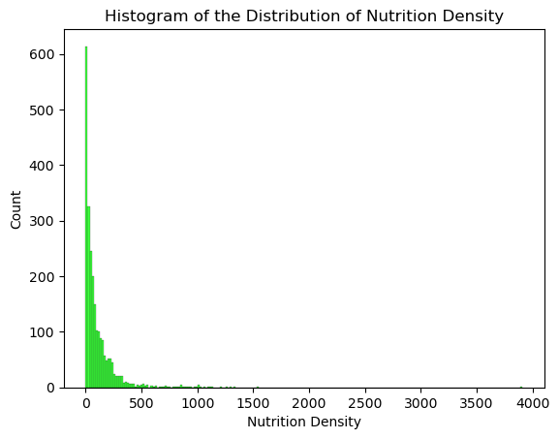
Histogram EDA

Slide 7
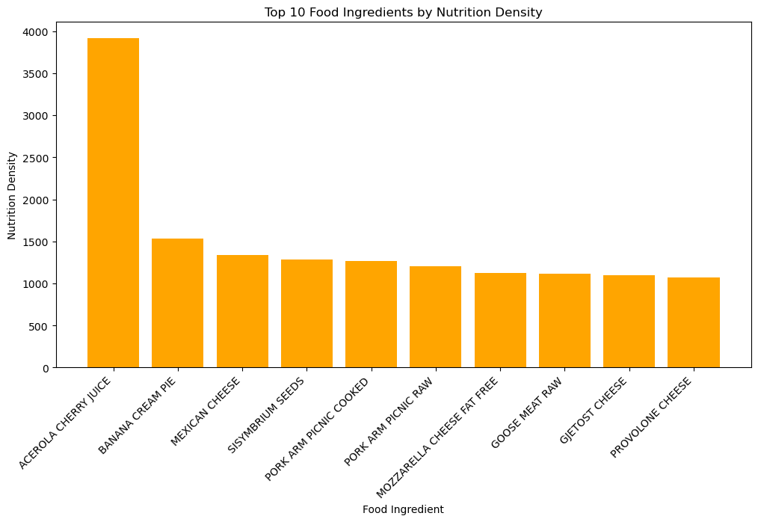
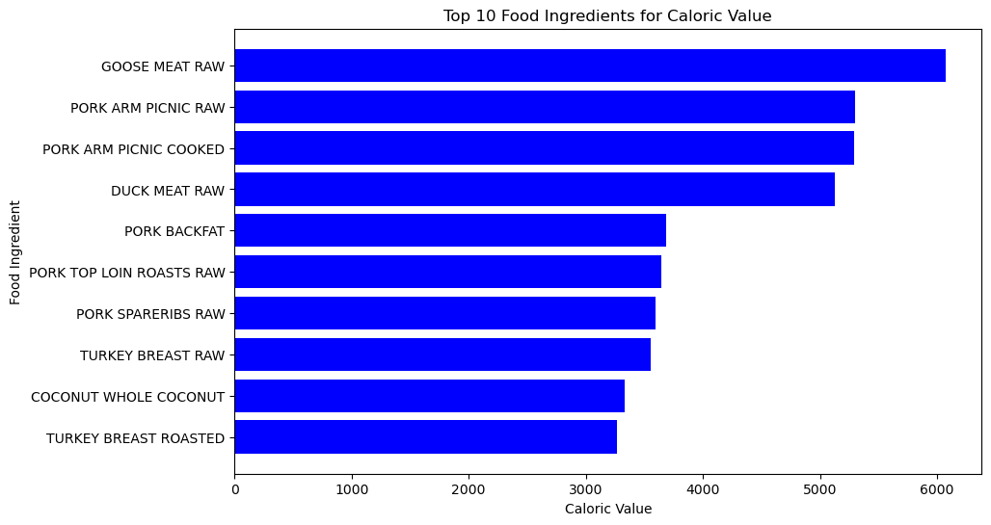
Bar Chart EDA

Slide 8
Data Preparation
Combined the five datasets into one all-inclusive dataset
Removed irrelevant columns
Corrected the data types within the dataset

Slide 9
Modeling
Model 1: Ordinary Least Squares Model with L2 Normalization
Model 2: Ensemble Stacking Regressor using Decision Tree, Random Forest, and Gradient Boosting Regressors

Slide 10
Results
Model | RMSE | R²
OLS Model with L2 Normalization | 0.0328 | 0.999
Decision Tree | 41.494 | 0.938
Random Forest | 34.893 | 0.956
Gradient Boosting Regressor | 27.042 | 0.974
Ensemble Stacking Regressor Model | 24.651 | 0.978

Slide 11
Feature Importance
Decision Tree
Random Forest
Gradient Boosting
Variable Name | Relative Importance
Calcium | 0.5451
Vitamin C | 0.2703
Caloric Value | 0.1070
Phosphorus | 0.0321
Dietary Fiber | 0.0120
Variable Name | Relative Importance
Calcium | 0.5793
Vitamin C | 0.2414
Caloric Value | 0.0850
Saturated Fats | 0.0178
Carbohydrates | 0.0106
Variable Name | Relative Importance
Calcium | 0.5559
Vitamin C | 0.2746
Caloric Value | 0.0980
Phosphorus | 0.0160
Potassium | 0.0068

Slide 12
Conclusions
While the initial model choice performed too well (suggesting overfitting), the stacking regressor performed the best with an RMSE of 24.651 and R² of 0.978
These metrics suggest that the ensemble model exhibits high predictive power
This model is tentatively ready for deployment

Slide 13
Future Recommendations
Calcium is shown to be the most important feature regarding the prediction of nutrition density, so foods high in calcium significantly impact nutrition density
Other macro/micronutrients variables like Caloric Value, Vitamin C, and Phosphorus are to be considered as well due to their feature importance and/or highly positive correlation
More data is to be gathered to enhance the model’s predictive power even further before deployment

Slide 14
Sources
Drewnowski, A., & Fulgoni, V. L. (2014). Nutrient density: Principles and evaluation tools. The American Journal of Clinical Nutrition, 99(5), 1223S-1228S. https://doi.org/10.3945/ajcn.113.073395.
Drewnowski, A., Dwyer, J., King, J. C., & Weaver, C. M. (2019). A proposed nutrient density score that includes food groups and nutrients to better align with dietary guidance. Nutrition Reviews, 77(6), 404-416. https://doi.org/10.1093/nutrit/nuz002
Utsav Dey. (2024). Food Nutrition Dataset [Data set]. Kaggle. https://doi.org/10.34740/KAGGLE/DSV/8820139

